Slide 1
1-Click Deployment of Bitcoin Full Node
Out of box setup for bitcoin which includes bitcoind & Bitcoin QT GUI wallet & synced ledger
Key benefits
Fully Synced Bitcoin Full Node for Development Purpose
The “Bitcoin Fullnode” VM solution by Techlatest.net makes it very easy for anyone to setup Bitcoin fullnode in just couple of minutes by pre-syncing the ledger.
One click setup for Bitcoin which will save days it takes to sync bitcoin ledger.
Bitcoind & Bitcoin QT GUI wallet accessible via remote desktop
Save the data transfer cost of the initial ledger sync which can go in several hundreds of dollars.
Use fully synced ledger for various activities like Bitcoin app development
The Bitcoin blockchain is designed as a decentralized P2P network where nobody owns or controls Bitcoin and everyone can take part. A full node is a program that fully validates transactions and blocks. Bitcoin requires a one-time download of about 300GB+ of data and a further 5–10GB per month. You need a dedicated device for this purpose which is scalable as well.
Techlatest.net provides 1-click deployment of Bitcoin Full Node on AWS which comes with pre-synced ledger along with the required support to its customers.
Product features
Gives you full control
In the possible event of a hard fork where both block chains remain active with economic activity on each, running a full node is the only way you can validate the rules of the new or old block chain, according to your preference.
Ease of use
One Click solution makes it very easy for anyone to setup Bitcoin fullnode in just couple of minutes
Preinstalled setups include:
bitcoind & Bitcoin QT GUI wallet
Bitcoin-CLI
Benefit-cost ratio
Provision the solution from AWS cloud marketplace as and when required without any short- or long-term usage commitment
Note: This solution provides synced Bitcoin ledger for development purposes. It is not recommended to use it as hot wallet or for commercial transactions.

Slide 2
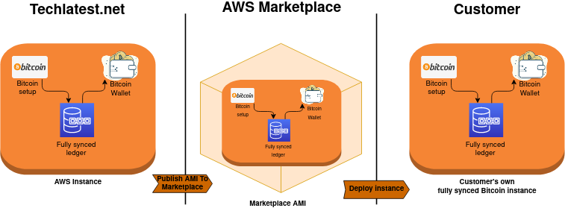
How it works
Bitcoin is not just a cryptocurrency, it’s a protocol and a network. Bitcoin nodes empowers Bitcoin’s decentralized peer-to-peer network. The VM solution comes with presynced bitcoin ledger . The ledger is 350GB plus in size and it keeps growing as new transactions are added on the ledger. The ledger on the VM continues to sync with the public ledger on internet after the VM is provisioned.
Differentiators
The Bitcoin Fullnode by Techlatest.net will provide one click setup for bitcoin and will save days it take to sync bitcoin ledger
Have your own fully synced ledger to use for various activities like bitcoin app development
Solution is accessible globally which assures availability and reliability.
Opensource nature of Bitcoin coupled with Techlatest support with AWS consumption-based billing, you pay as per your use

Slide 3
With The Bitcoin Full Node 1-click deployment from Techlatest.net, we are able to start the development in minutes with fully synced ledger. As the solution is cloud based scaling up as per need is far easier and cost saving.
Mohammed, Technical Director, SellOdoo
What our customers are saying
Product Specifications
Product | SKU | Description
Bitcoin Fullnode | bitcoin-fullnode-kit | Operating System: Linux/Unix, Ubuntu 18.04 AWS Services: EC2, 600 GB of Block Storage
Additional Resources
Call for more information: +966-591043176
Ask a question via email: info@techlatest.net
Learn more:
Bitcoin Fullnode Support
Get It On AWS
AWS Getting Started Guide
Solution available in AWS Marketplace

